Slide 1
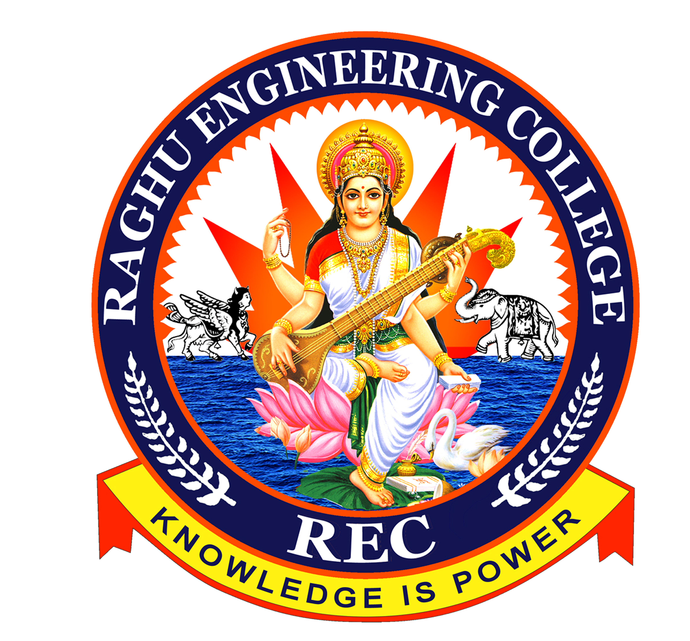
IMAGE FUSION
using DWT and DCT algorithms.
Under Guidance of:
Dr. G Ramesh Babu
Submitted by:
K Priyanka 15981A04E5
K S Raja Ganesh 15981A04F0
K Sai Mahesh 15981A04E7
M Bala Chandra 15981A04F7

Slide 2
CONTENTS
Abstract
Introduction
Objective
Methodology
Block diagram
Applications
Softwares
References

Slide 3
ABSTRACT
The objective of image fusion is to combine relevant information from multiple images into a single image. Result of image fusion is a single image which is more suitable for human and machine perception or further Image-processing tasks. The objective in image fusion is to reduce uncertainty and minimize redundancy in the output while maximizing relevant information particular to an application or task. Fusion is an important technique within many disparate fields such as remote sensing, robotics and medical applications. Fused images can provide information that sometimes cannot be observed in the individual input images. Successful image fusion significantly reduces the amount of data to be viewed or processed without significantly reducing the amount of relevant information. This project uses Discrete Wavelet Transform (DWT) algorithm and Discrete Cosine Transform (DCT) in this process. The performance of the algorithms are compared and the experimental results are verified and found the output image qualities are improved.

Slide 4
INTRODUCTION
Due to the limited depth of focus of optical lenses it is not possible to get an image that contains all relevant objects in focus.
However, for accurately interpreting and analyzing images, it is desired to obtain images with every object in focus.
Multifocus image fusion is an effective technique to solve this problem by combining two or more images of the same scene taken with different focus settings into a single all-in-focus image with extended depth of field.
The resultant fused image is very useful for human or machine perception.

Slide 5
OBJECTIVE
To reduce uncertainty and minimize redundancy in the output while maximizing relevant information particular to an application or task.
Result of image fusion is a single image which is more suitable for human and machine perception or further Image-processing tasks.

Slide 6
METHODOLOGY
Discrete Wavelet Transform (DWT)
Discrete Cosine Transform (DCT) + consistency verification

Slide 7
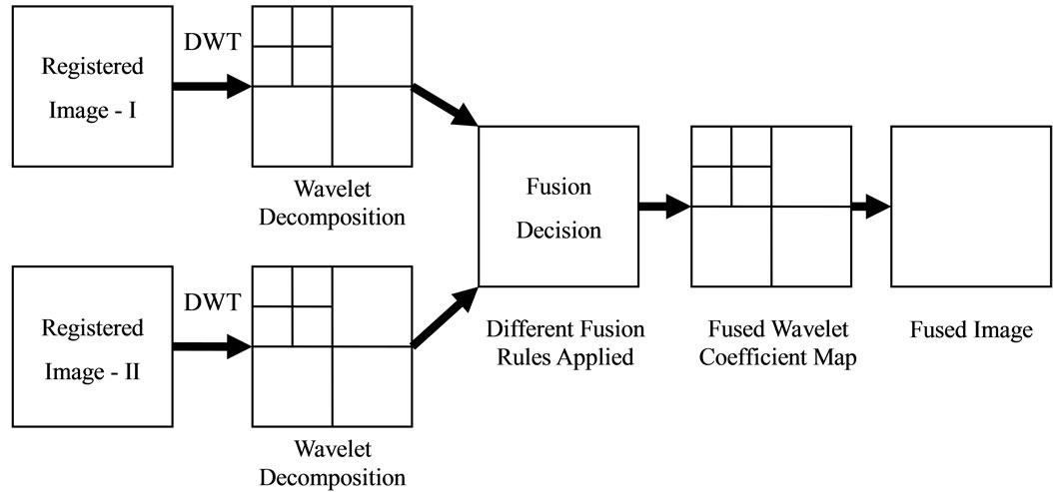
Discrete Wavelet Transform (DWT)

Slide 8
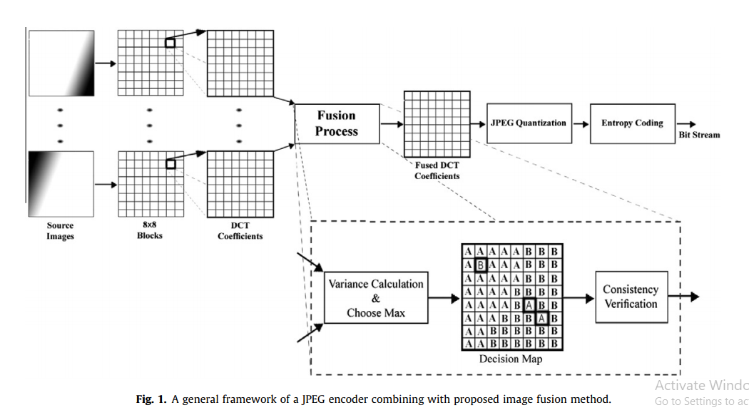
Discrete Cosine Transform (DCT) + consistency verification

Slide 9
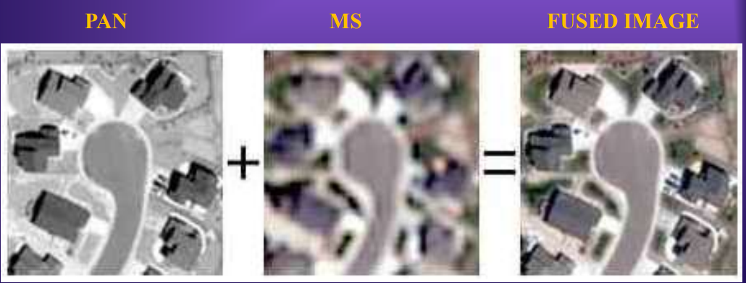
APPLICATIONS
Remote sensing - Image fusion in remote sensing has several application domains. An important domain is the multi-resolution image fusion. In satellite imagery we can have two types of images:
Panchromatic image
Multispectral image

Slide 10
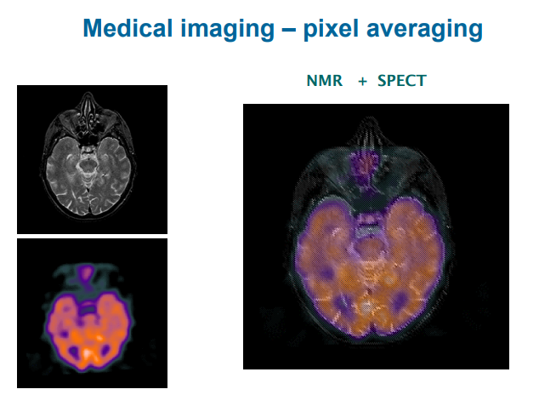
APPLICATIONS
Medical Image Fusion - Image fusion has become a common term used within medical diagnostics and treatment. Fused images may be created from multiple images from combining information from multiple modalities, such as
magnetic resonance image (MRI)
computed tomography (CT)
positron emission tomography (PET)

Slide 11
SOFTWARES
MATLAB – 2018 A

Slide 12
REFERENCES
A Review on Recent Improved Image Fusion Techniques K.C. Rajini, S. Roopa.
Multifocus Image Fusion Using Discrete Wavelet Transform And Sparse Representation Aishwarya N , Abirami S, Amutha R.
Multi-focus image fusion for visual sensor networks in DCT domain Mohammad Bagher Akbari Haghighat ,Ali Aghagolzadeh, Hadi Seyedarabi.

